Slide 1



ZOMATO_BI
View in Power BI
Last data refresh:
14/04/2021 09:42:15 UTC
Downloaded at:
13/05/2021 09:48:50 UTC

Slide 2
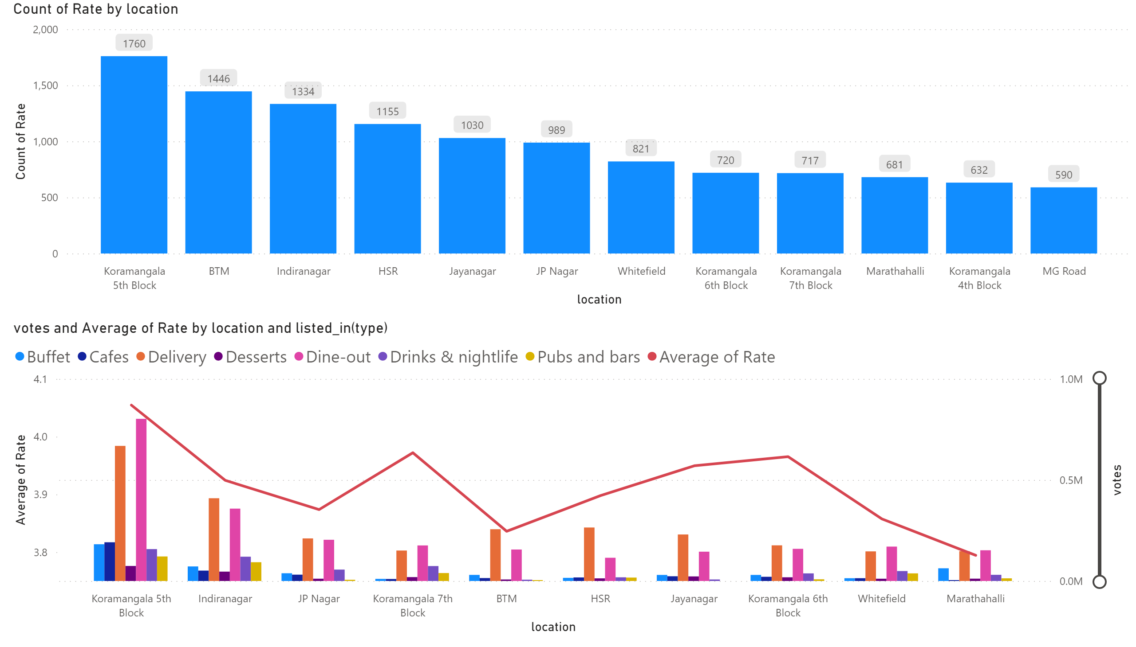
Page 0
Notes:
columnChart
No alt text provided.
lineClusteredColumnComboChart
No alt text provided.

Slide 3
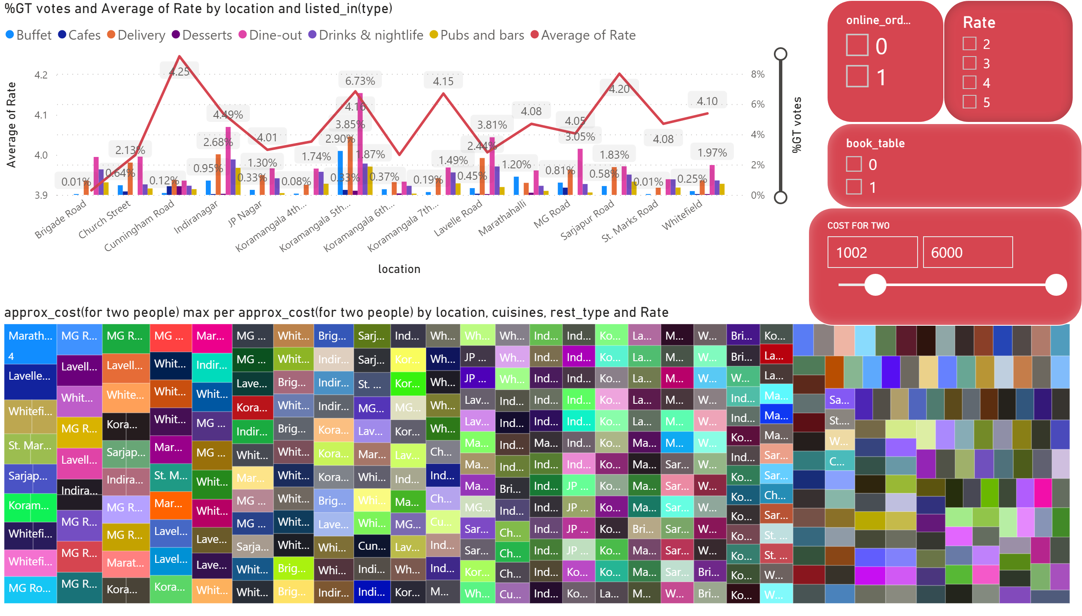
Page 4
Notes:
lineClusteredColumnComboChart
No alt text provided.
treemap
No alt text provided.
slicer
No alt text provided.
slicer
No alt text provided.
slicer
No alt text provided.
slicer
No alt text provided.

Slide 4
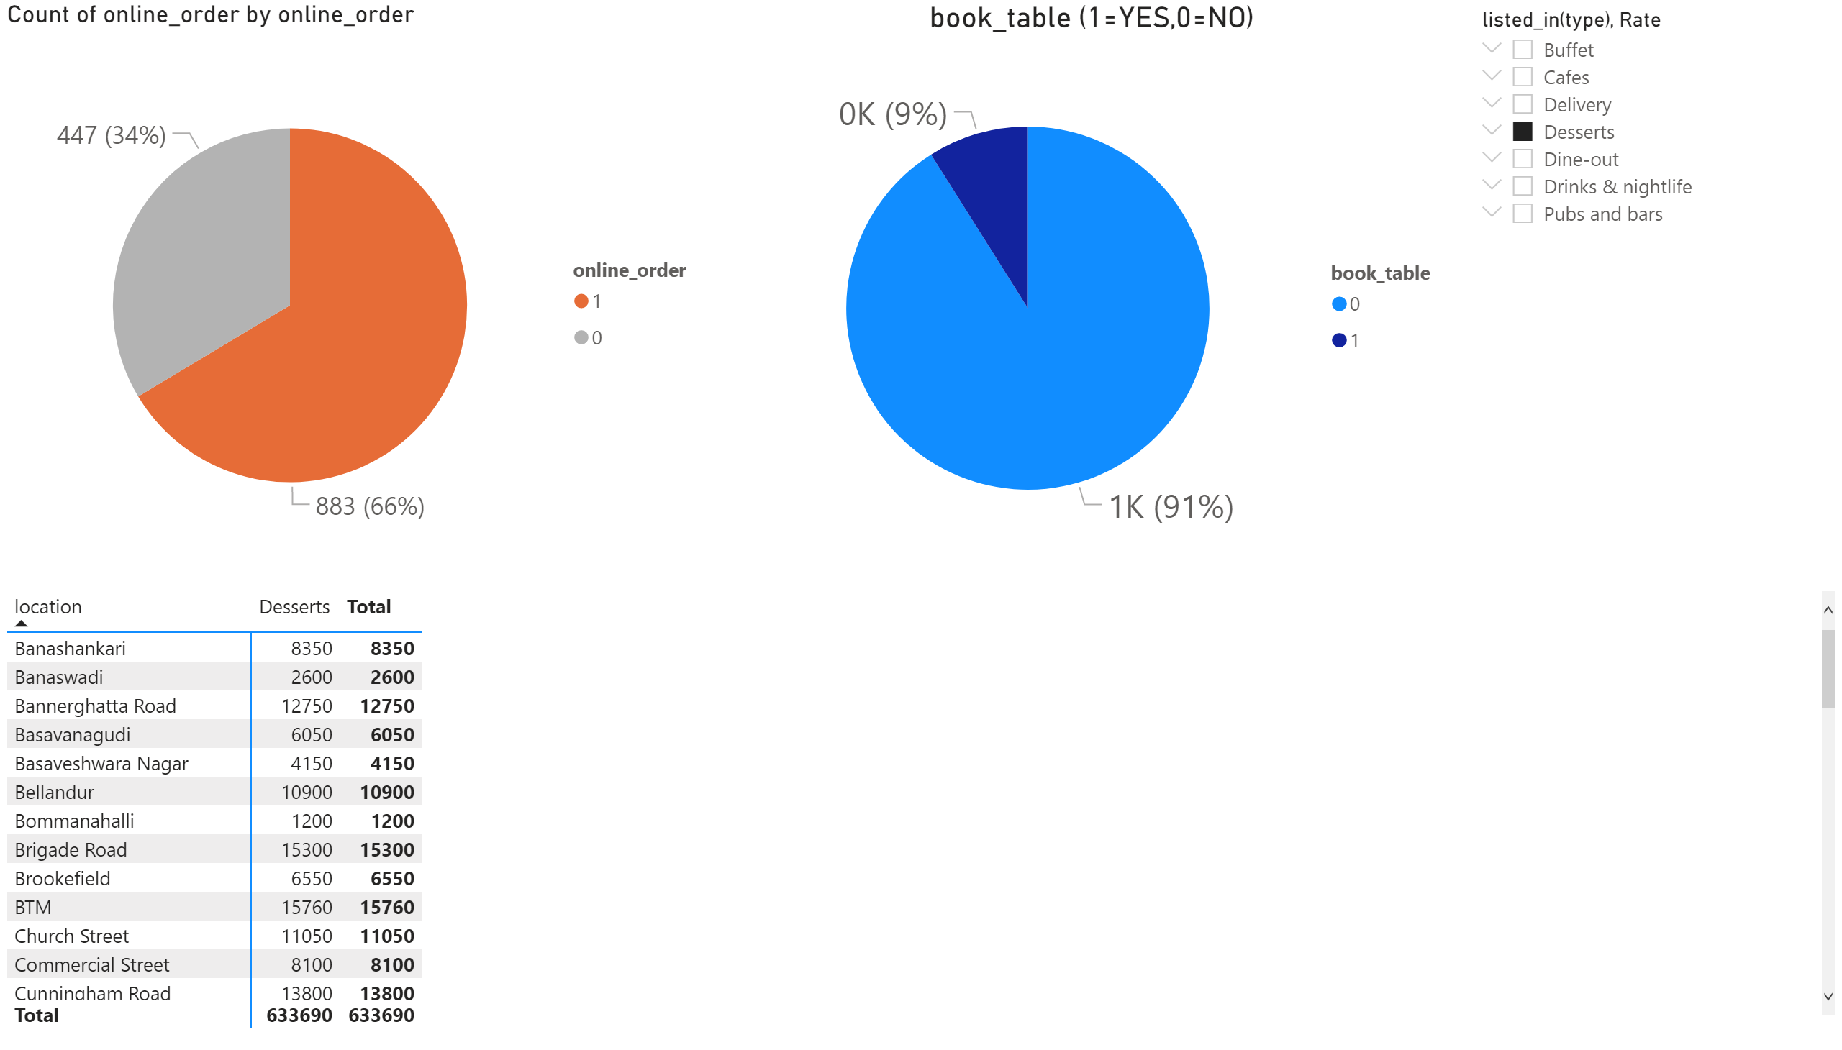
Page 1
Notes:
slicer
No alt text provided.
pivotTable
No alt text provided.
book_table (1=YES,0=NO)
No alt text provided.
pieChart
No alt text provided.

